Slide 1
Detection of Hate Speech using BERT and Hate Speech
Word Embedding with Deep Model
Hind Saleh, Areej Alhothalib, and Kawthar Moriab
Presented By
Refat Ishrak Hemel
ID: 3810002

Slide 2
Outlines:
Problem Overview and Background
Methodologies: Two Approaches
Experimental Results and Findings
Importance of Domain-Specific Embeddings
Explainability Analysis
Conclusion and Future Work

Slide 3
Overview
Rise of social Media
Concern about mental health
use abbreviations, intentional spelling mistakes, and coded words
Word representation plays a pivotal role.
investigates the feasibility of leveraging domain-specific word embedding as features and a bidirectional LSTM-based deep model as a classifier
investigate the use of the transfer learning language model (BERT)
The experiments showed that domain-specific word embedding with the bidirectional LSTM-based deep model achieved a 93% F1 score, while BERT achieved a 96% F1 score on a combined balanced dataset from available hate speech datasets.
The first approach was very helpful to detect coded words, while the second approach achieved better performance because it is trained on much larger data.

Slide 4
Overview (cont.)
Importance contribution of this Survey Paper
An unsupervised domain-specific word embedding model was developed.
A comparison between the domain-specific and domain-agnostic embedding was provided.
BiLSTM-based deep model with domain-specific embeddings shows an improvement ranging from 5 to 6 points on available datasets over the state-of-the-art techniques.

Slide 5
BACKGROUND
Word Embedding
Word embedding (Bengio et al. 2003) is a prominent natural language processing (NLP) technique that seeks to convey the semantic meaning of a word.
1.1) Word2vec
1.2) GloVe

Slide 6
BACKGROUND (cont.)
2) BiLSTM
3) BERT

Slide 7
Methodologies
Approach 1: Domain-Specific Embedding Features with BiLstm Based Deep
Approach 2: BERT Language Model

Slide 8
Experiment and Results
Datasets
  Davidson-ICWSM
  Waseem-EMNLP
  Waseem-NAACL

Slide 9
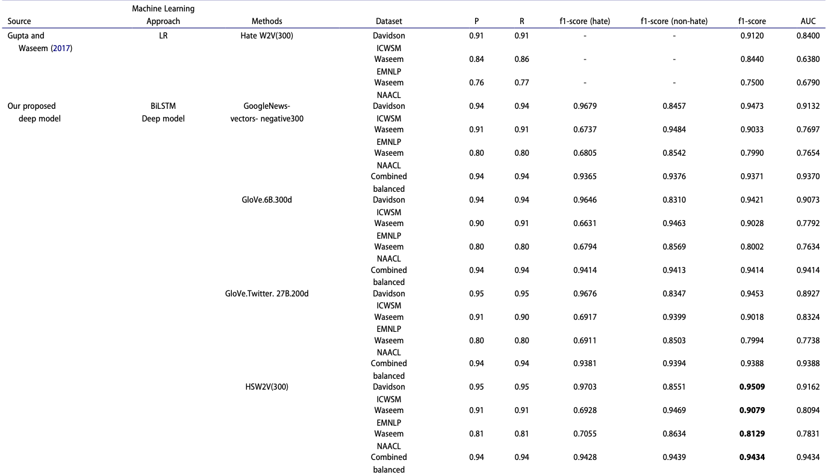
Experiment and Results
Approach 1

Slide 10
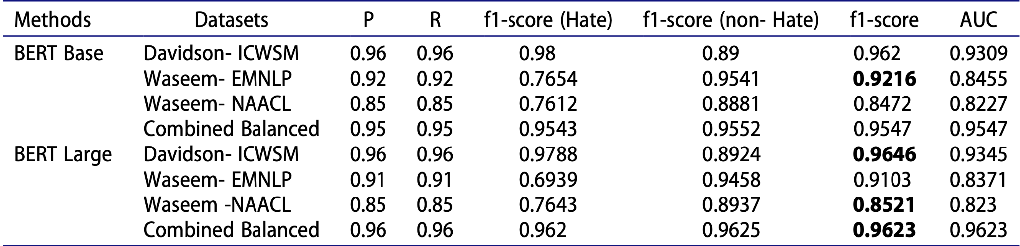
Experiment and Results
Approach 2

Slide 11
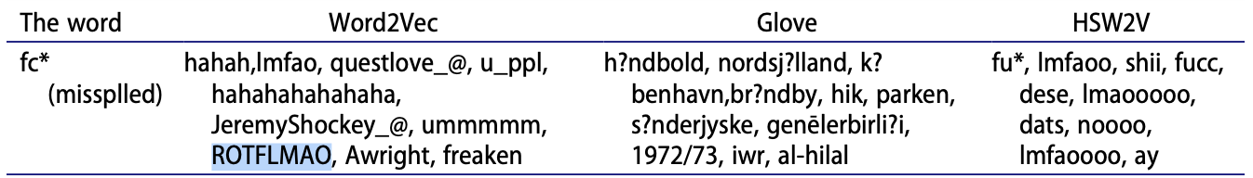
Importance of Domain-Specific Embeddings
We applied word similarity, which finds the closest word to the input word according to the cosine distance between them. Table 5 shows the result of applying word similarity to an intentionally misspelled word that is commonly used by the hate community (fc*). As shown in the table, domain-agnostic embedding models failed to retrieve similar words, while our HSW2 V was able to retrieve other intentionally misspelled words that were close in meaning to the input word.

Slide 12
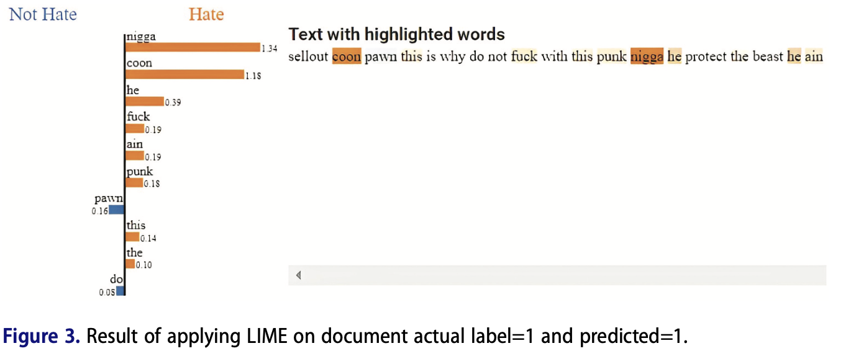
Explainability Analysis

Slide 13
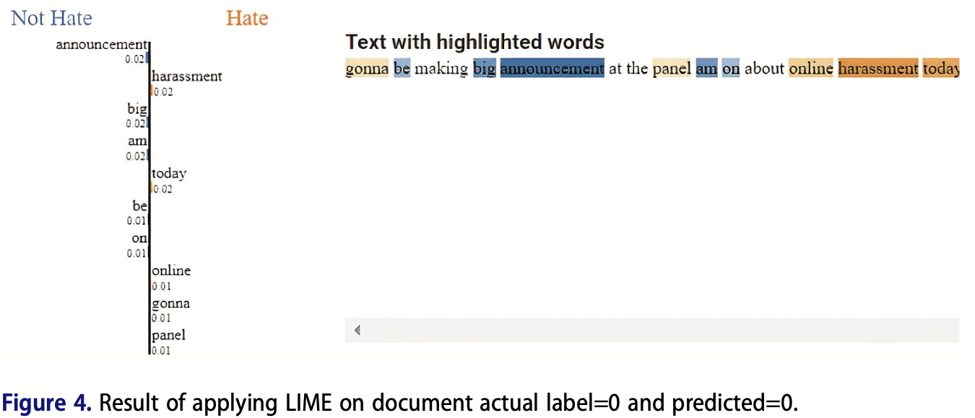
Explainability Analysis

Slide 14
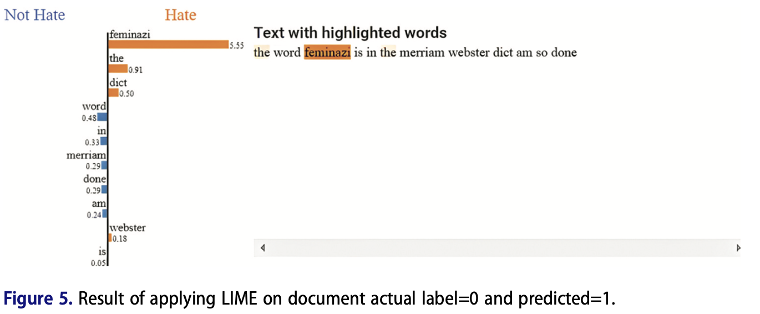
Explainability Analysis

Slide 15
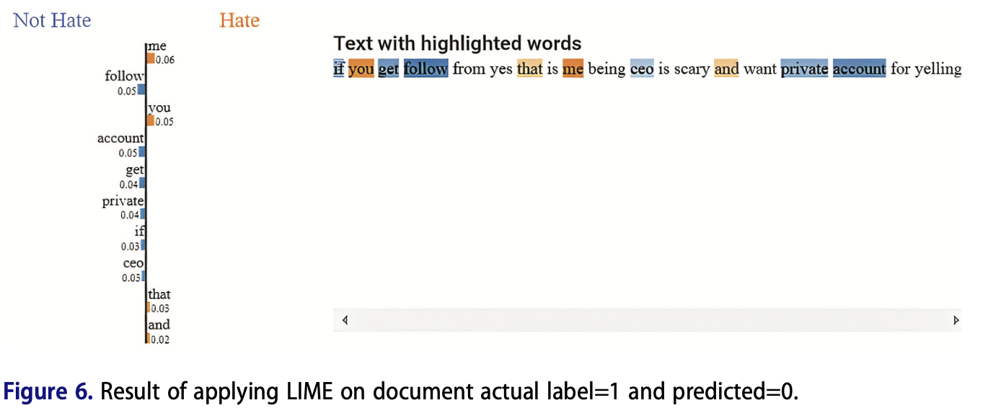
Explainability Analysis

Slide 16
Conclusion
To conclude, BERT design provides an appropriate feature extraction and
classification procedure for hate speech detection. BERT combines the benefits
of domain-agnostic and domain-specific word embedding by training the
model on vast data and then adding an extra layer to train on domain-
specific data (fine-tuning). BERT also saves effort and time in building an
embedding model from scratch. However, domain-specific word embedding
overcomes the BERT model in that it can detect hate terms and abbreviations
and intentionally misspell meanings. One of the challenges that we faced
during the experiments is that identifying hate speech is a highly subjective
task in which the machine may also encounter some difficulties in the detection.
The impact of this paper is mainly proven by experiments that BERT
Model provides acceptable performance in dealing with a hate speech problem.
This paper could be used for comparison for future work studies,
especially after changing hate speech policies on Twitter. This study can be
extended to detect multi-class hate speech for future work.

Slide 17
References
[1] Li, Y., Guo, Z., Yang, N., Chen, H., Yuan, D., & Ding, W. (2024). Threats and Defenses in Federated Learning Life Cycle: A Comprehensive Survey and Challenges. arXiv preprint arXiv:2407.06754.

